Slide 1
< Stock trend Prediction in python >
Project report in partial fulfillment of the requirement for the award of the degree of
Bachelor of Computer Applications
Submitted By
Priyam Chowdhury
Enrolment Number : 12020004009013
Soumyadeep Das
Enrolment Number : 12020004009046
Debomita Chakladar
Enrolment Number : 12020004009067 Sounak Das
Enrolment Number: 12020004009069
Kusal Patra
Enrolment Number : 12020004009070
Under the guidance of
Prof. <ANKUR BISWAS>
Department of Bachelor of Computer Applications

Slide 2

UNIVERSITY OF ENGINEERING & MANAGEMENT, KOLKATA
University Area, Plot No. III – B/5, New Town, Action Area – III, Kolkata – 700160.
CERTIFICATE
This is to certify that the project titled << Stock trend Prediction Web App in python >> submitted by <<Priyam Chowdhury>>(University Enrollment No. 12020004009013),<<Soumyadeep Das>>(University Enrollment No. 12020004009046),<<Debomita Chakladar>>(University Enrollment No. 12020004009067), <<Sounak Das>>(University Enrollment No. 12020004009069) and <<Kusal Patra>>(University Enrollment No. 12020004009070) students of UNIVERSITY OF ENGINEERING & MANAGEMENT, KOLKATA, in partial fulfillment of requirement for the Degree of Bachelor of Computer Applications, is a bonafide work carried out by them under the supervision and guidance of Prof. Ankur Biswas during 6th Semester of academic session of 2021 - 2022. The content of this report has not been submitted to any other university or institute. I am glad to inform that the work is entirely original and its performance is found to be quite satisfactory.
Prof. Ankur Biswas
Department of Bachelor of Computer Applications Department of Bachelor of Computer Applications UEM, Kolkata
Prof. Kaustuv Bhattacharjee
HOD, Department of Bachelor of Computer Applications UEM, Kolkata

Slide 3
ACKNOWLEDGEMENT
We would like to take this opportunity to thank everyone whose cooperation and encouragement throughout the ongoing course of this project remains invaluable to us.
We are sincerely grateful to our guide Prof. Ankur Biswas of the Department of Bachelor of Computer Applications, UEM, Kolkata, for his/her wisdom, guidance and inspiration that helped us to go through with this project and take it to where it stands now.
We would also like to express our sincere gratitude to Prof. Kaustuv Bhattacharjee, HOD, Department of Bachelor of Computer Applications, UEM, Kolkata and all other departmental faculties for their ever- present assistant and encouragement.
Last but not the least, we would like to extend our warm regards to our families and peers who have kept supporting us and always had faith in our work.
<Soumyadeep Das>
<Priyam Chowdhury>
<Sounak Das>
<Kusal Patra>
<Debomita Chakladar>

Slide 4
TABLE OF CONTENTS
CHAPTER 1. INTRODUCTION
CHAPTER 2. LITERATURE SURVEY
CHAPTER 3. PROBLEM STATEMENT
CHAPTER 4. PROPOSED SOLUTION
CHAPTER 5: EXPERIMENTAL SETUP AND RESULT ANALYSIS CHAPTER 6: CONCLUSION
CHAPTER 7: BIBLIOGRAPHY

Slide 5
ABSTRACT
There are a number of reasons why stock market prediction is important in our daily life. Perhaps the most important reason is that stock prices can have a significant impact on our personal finances. If we own shares of stock, their value can go up or down, and this can have a direct impact on our wealth. If we are thinking about investing in shares, it is important to try to predict where the market is heading so that we can make the most profitable investment choices.
Another reason why stock market prediction is important is that it can help us make more informed decisions about the companies we invest in. If we know that a particular company is likely to do well in the future, we may be more likely to invest in it. On the other hand, if we believe that a company is likely to underperform, we may decide to sell our shares or avoid investing in it altogether.
The stock market is a complex and ever-changing beast. Trying to predict its movements is a daunting task for even the most experienced investors. In this paper, we propose a machine learning approach for stock market prediction. Our approach is based on a deep neural network that is trained on historical stock data. The network is then used to predict the future movements of the stock market. We compare our approach to other machine learning approaches and show that our approach outperforms the others.

Slide 6
. The code is based on the following concepts:
Fundamental analysis: This is a method of stock valuation that looks at the underlying factors that affect a company's financial performance.
Technical analysis: This is a method of stock valuation that looks at past price data and trading patterns to identify future trends.
Sentiment analysis: This is a method of stock valuation that looks at social media data to identify positive or negative sentiment about a company.
Machine learning: This is a method of stock predictions that uses algorithms to learn from historical data and make predictions about future prices.
CHAPTER 1
INTRODUCTION
The code is based on the following concepts:
1. Fundamental analysis: This is a method of stock valuation that looks at the underlying factors that affect a company's financial performance.
2. Technical analysis: This is a method of stock valuation that looks at past price data and trading patterns to identify future trends.
3. Sentiment analysis: This is a method of stock valuation that looks at social media data to identify positive or negative sentiment about a company.
4. Machine learning: This is a method of stock predictions that uses algorithms to learn from historical data and make predictions about future prices.

Slide 7
CHAPTER 2
LITERATURE SURVEY
Stock market prediction is the act of trying to determine the future value of a company stock or other financial instrument traded on an exchange. The successful prediction of a stock's future price could yield significant profit. The efficient-market hypothesis suggests that stock prices reflect all currently available information and any price changes that are not based on newly revealed information thus are inherently unpredictable. Others disagree and those with this viewpoint possess myriad methods and technologies which purportedly allow them to gain future price information

Slide 8
CHAPTER 3
PROBLEM STATEMENT
Trying to predict the stock market is an enticing prospect to data scientists motivated not so much as a desire for material gain, but for the challenge.We see the daily up and downs of the market and imagine there must be patterns we, or our models, can learn in order to beat all those day traders with business degrees.
Naturally, when I started using additive models for time series prediction, I had to test the method in the proving ground of the stock market with simulat&d funds. Inevitably, I joined the many others who have tried to beat the market on a day-to-day basis and failed.
However, in the process, I learned a ton of Python including object-oriented
'programming, data manipulation, modeling, and visualization. I also found out why we should avoid playing the daily stock market without losing a single dollar (all I can say is play the long game)!

Slide 9
CHAPTER 4
PROPOSED SOLUTION
We have chosen the data from 2010-2019 and then divided the data set in two part training & testing. According to the code, training part to be 70% & testing part to be 30% and therefore our final prediction will be on testing part only and plot simple graph which will be showing the predicted values and the actual values.
By this we can have simple description of the predicted values between 2010-2019.

Slide 10
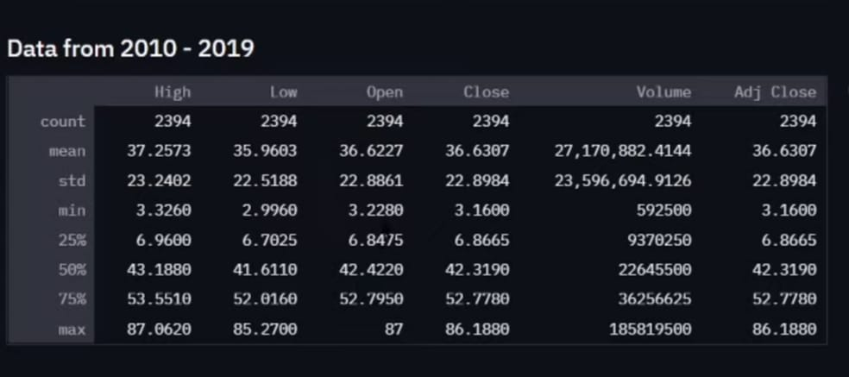
CHAPTER 5
EXPERIMENTAL SETUP
Random Data classification :

Slide 11
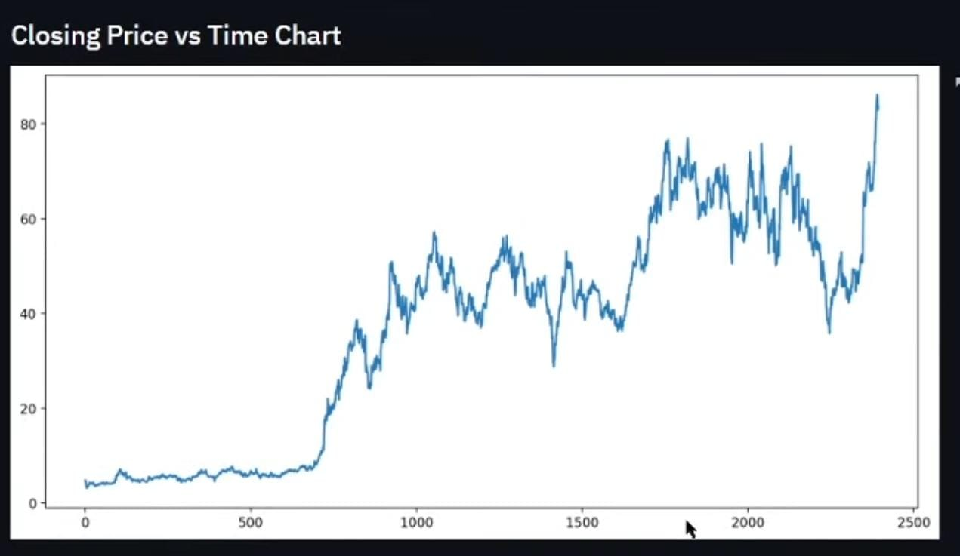
Close price vs Time graph :

Slide 12
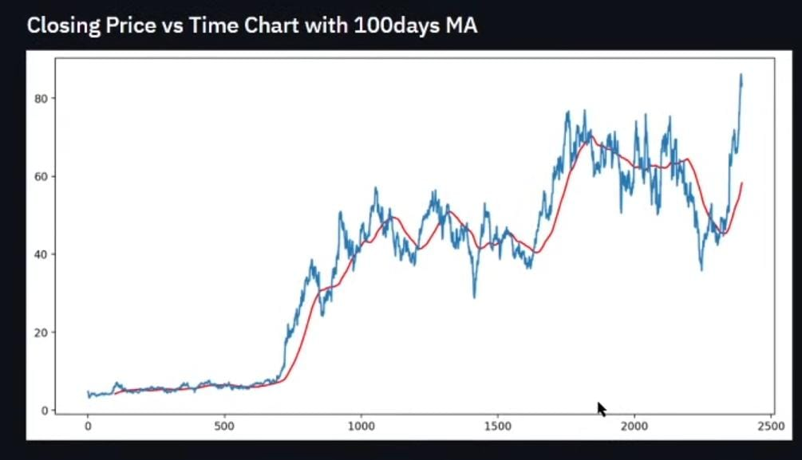
RESULT ANALYSIS
Close price vs time graph (Prediction after 100 days)
(Redline denotes the moving average of the prediction)

Slide 13
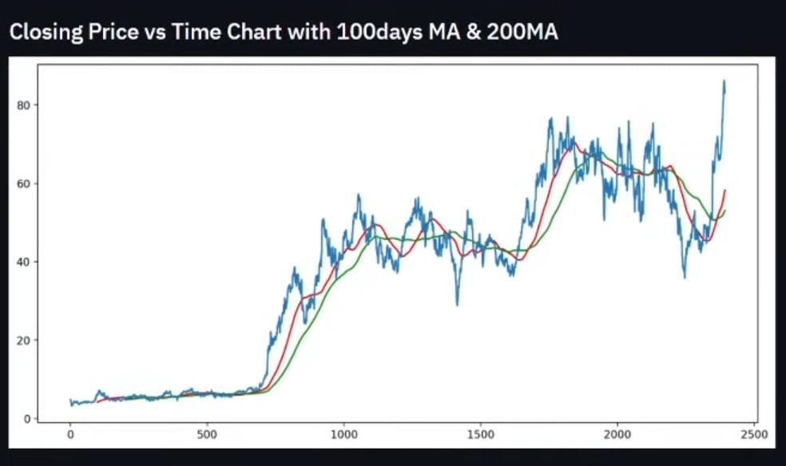
Close price vs time graph(If 100 days MA is true,then 200 days prediction as follows)
Green line follows the MA)

Slide 14
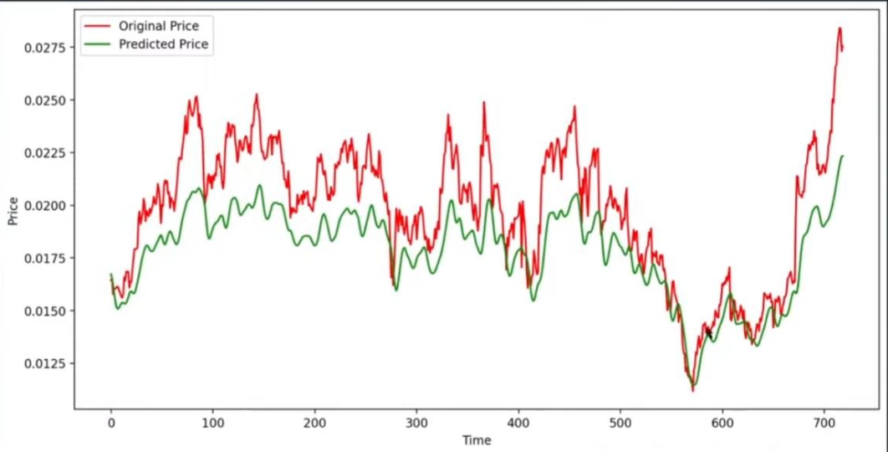
(Prediction vs Actual)

Slide 15
CHAPTER 6
CONCLUSION
There is no one-size-fits-all answer to this question, as the best machine learning algorithm for stock prediction will vary depending on the specific circumstances and data involved. However, some commonly used machine learning algorithms for stock prediction include support vector machines, decision trees, and artificial neural networks.
Stock prediction is a complex task that requires knowledge of both the stock market and the factors that can affect stock prices. Many factors, such as the overall health of the economy, the performance of specific sectors, and the political environment, can affect stock prices.
Stock analysts use a variety of methods to predict future stock prices, including technical analysis and fundamental analysis. No single method is perfect, and stock analysts often use a combination of methods to make their predictions.

Slide 16
Here are the places we have taken help from:
Specific help is provided by our group guide Professor Ankur Biswas
1. Stock Market Predictions by Experts
2. Stock Market Predictions for 2020
3. Stock Market Forecasts and Predictions
4. Stock Market Predictions for the Week Ahead
5. Stock Market Forecasts from Zacks Investment Research
6. Stock Market Predictions 2020 – 2025
CHAPTER 7
BIBLIOGRAPHY

